Slide 1
Recursion
Lecture 3

Slide 2
Chapter Objectives
To understand how to think recursively
To learn how to trace a recursive method
To learn how to write recursive algorithms and methods for searching arrays
To understand how to use recursion to process two-dimensional images
To learn how to apply backtracking to solve search problems such as finding a path through a maze
Chapter 7: Recursion

Slide 3
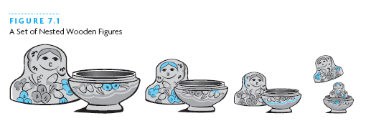
Recursive Thinking
Recursion is a problem-solving approach that can be used to generate simple solutions to certain kinds of problems that would be difficult to solve in other ways
Recursion splits a problem into one or more simpler versions of itself
Chapter 7: Recursion

Slide 4
Steps to Design a Recursive Algorithm
There must be at least one case (the base case), for a small value of n, that can be solved directly
A problem of a given size n can be split into one or more smaller versions of the same problem (recursive case)
Recognize the base case and provide a solution to it
Devise a strategy to split the problem into smaller versions of itself while making progress toward the base case
Combine the solutions of the smaller problems in such a way as to solve the larger problem
Chapter 7: Recursion

Slide 5
Proving that a Recursive Method is Correct
Proof by induction
  Prove the theorem is true for the base case
  Show that if the theorem is assumed true for n, then it must be true for n+1
Recursive proof is similar to induction
  Verify the base case is recognized and solved correctly
  Verify that each recursive case makes progress towards the base case
  Verify that if all smaller problems are solved correctly, then the original problem is also solved correctly
Chapter 7: Recursion

Slide 6
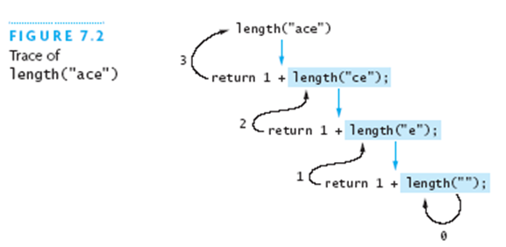
Tracing a Recursive Method
Chapter 7: Recursion

Slide 7
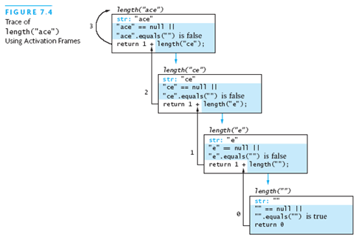
Tracing a Recursive Method
Chapter 7: Recursion

Slide 8
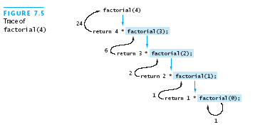
Recursive Definitions of Mathematical Formulas
Mathematicians often use recursive definitions of formulas that lead very naturally to recursive algorithms
Examples include:
  Factorial
  Powers
  Greatest common divisor
If a recursive function never reaches its base case, a stack overflow error occurs
Chapter 7: Recursion

Slide 9
Recursion Versus Iteration
There are similarities between recursion and iteration
In iteration, a loop repetition condition determines whether to repeat the loop body or exit from the loop
In recursion, the condition usually tests for a base case
You can always write an iterative solution to a problem that is solvable by recursion
Recursive code may be simpler than an iterative algorithm and thus easier to write, read, and debug
Chapter 7: Recursion

Slide 10
Efficiency of Recursion
Recursive methods often have slower execution times when compared to their iterative counterparts
The overhead for loop repetition is smaller than the overhead for a method call and return
If it is easier to conceptualize an algorithm using recursion, then you should code it as a recursive method
The reduction in efficiency does not outweigh the advantage of readable code that is easy to debug
Chapter 7: Recursion

Slide 11
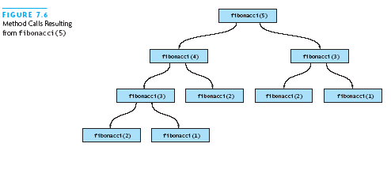
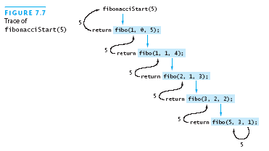
Efficiency of Recursion (continued)
Inefficient
Efficient
Chapter 7: Recursion

Slide 12
Recursive Array Search
Searching an array can be accomplished using recursion
Simplest way to search is a linear search
  Examine one element at a time starting with the first element and ending with the last
Base case for recursive search is an empty array
  Result is negative one
Another base case would be when the array element being examined matches the target
Recursive step is to search the rest of the array, excluding the element just examined
Chapter 7: Recursion

Slide 13
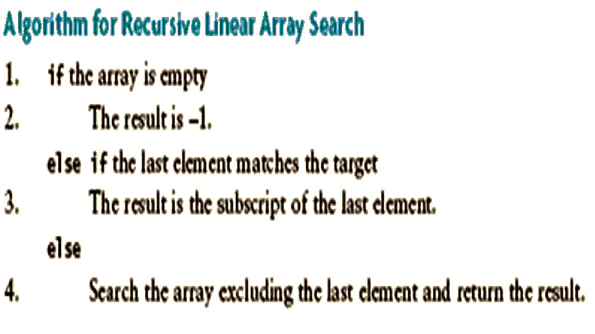
Algorithm for Recursive Linear Array Search
Chapter 7: Recursion

Slide 14
Design of a Binary Search Algorithm
Binary search can be performed only on an array that has been sorted
Stop cases
  The array is empty
  Element being examined matches the target
Checks the middle element for a match with the target
Throw away the half of the array that the target cannot lie within
Chapter 7: Recursion

Slide 15
Recursive Data Structures
Computer scientists often encounter data structures that are defined recursively
  Trees are defined recursively
  Linked list can be described as a recursive data structure
Recursive methods provide a very natural mechanism for processing recursive data structures
The first language developed for artificial intelligence research was a recursive language called LISP
Chapter 7: Recursion

Slide 16
Counting Cells in a Blob
Consider how we might process an image that is presented as a two-dimensional array of color values
Information in the image may come from:
  X-Ray
  MRI
  Satellite imagery
  Etc.
Goal is to determine the size of any area in the image that is considered abnormal because of its color values
Chapter 7: Recursion

Slide 17
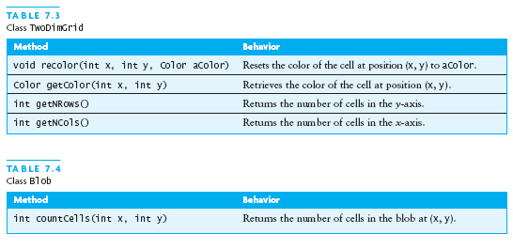
Counting Cells in a Blob (continued)
Chapter 7: Recursion

Slide 18
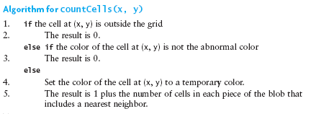
Counting Cells in a Blob (continued)
Chapter 7: Recursion

Slide 19
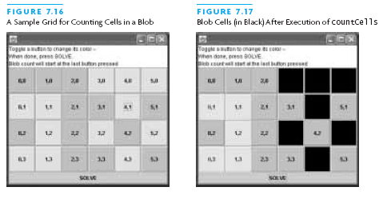
Counting Cells in a Blob (continued)
Chapter 7: Recursion

Slide 20
Backtracking
Backtracking is an approach to implementing systematic trial and error in a search for a solution.
  An example is finding a path through a maze
If you are attempting to walk through a maze, you will probably walk down a path as far as you can go.
    Eventually, you will reach your destination or you won’t be able to go any farther.
    If you can’t go any farther, you will need to retrace your steps.
Backtracking is a systematic approach to trying alternative paths and eliminating them if they don’t work
Chapter 7: Recursion

Slide 21
Backtracking (continued)
Never try the exact same path more than once, and you will eventually find a solution path if one exists
Problems that are solved by backtracking can be described as a set of choices made by some method
Recursion allows us to implement backtracking in a relatively straightforward manner
  Each activation frame is used to remember the choice that was made at that particular decision point
A program that plays chess may involve some kind of backtracking algorithm
Chapter 7: Recursion

Slide 22
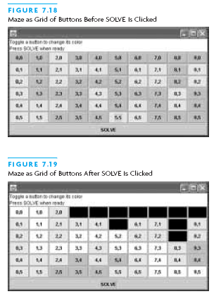
Backtracking (continued)
Chapter 7: Recursion

Slide 23
Chapter Review
A recursive method has a standard form
To prove that a recursive algorithm is correct, you must
  Verify that the base case is recognized and solved correctly
  Verify that each recursive case makes progress toward the base case
  Verify that if all smaller problems are solved correctly, then the original problem must also be solved correctly
The run-time stack uses activation frames to keep track of argument values and return points during recursive method calls
Chapter 7: Recursion

Slide 24
Chapter Review (continued)
Mathematical Sequences and formulas that are defined recursively can be implemented naturally as recursive methods
Recursive data structures are data structures that have a component that is the same data structure
Backtracking is a technique that enables you to write programs that can be used to explore different alternative paths in a search for a solution
Chapter 7: Recursion

